Slide 1
Computer Graphics Rendering
Lecture 16: Fast rendering pipelines (history)
Kartic Subr

Slide 3



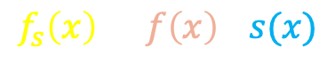



Sampling = multiplication
$$|S\left(ω\right)|$$
$$f_{s}\left(x\right)=f\left(x\right) . s(x)$$
-$ω$
0
+$ω$
sampled function
sampling function
$$|F\left(ω\right)|$$
-$ω$
0
+$ω$

Slide 4








Functions in Fourier domain
primal
$$|F\left(ω\right)|$$
$$⟺$$
Fourier
dual
-$ω$
0
+$ω$
x
$$|S\left(ω\right)|$$
Fourier
dual
$$⟺$$
x
-$ω$
0
+$ω$

Slide 5
Convolution theorem
$$|F\left(ω\right)|$$
MULTIPLY
=
CONVOLVE
-$ω$
0
+$ω$
x
$$|S\left(ω\right)|$$
x
-$ω$
0
+$ω$

Slide 6
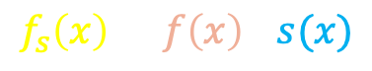



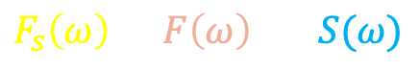
Sampling = convolution (Fourier domain)
$$f_{s}\left(x\right)=f\left(x\right) . s(x)$$
$$F_{s}\left(ω\right)=F\left(ω\right) ⊗S(ω)$$
$$|F\left(ω\right)|$$
MULTIPLY
-$ω$
0
+$ω$
CONVOLVE
$$|S\left(ω\right)|$$
-$ω$
0
+$ω$

Slide 7

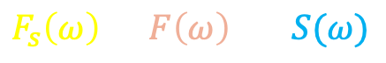

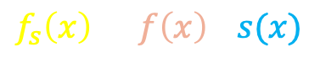
Convolution results in overlapping spectra
$$f_{s}\left(x\right)=f\left(x\right) . s(x)$$
$$|F\left(ω\right)|$$
$$F_{s}\left(ω\right)=F\left(ω\right) ⊗S(ω)$$
-$ω$
0
+$ω$
CONVOLVE
MULTIPLY
$$|S\left(ω\right)|$$
-$ω$
0
+$ω$

Slide 8
To move these away, change sampling function
$$f_{s}\left(x\right)=f\left(x\right) . s(x)$$
$$|F\left(ω\right)|$$
$$F_{s}\left(ω\right)=F\left(ω\right) ⊗S(ω)$$
-$ω$
0
+$ω$
CONVOLVE
MULTIPLY
$$|S\left(ω\right)|$$
Change
-$ω$
0
+$ω$

Slide 9
Stretching S to higher frequencies …
$$f_{s}\left(x\right)=f\left(x\right) . s(x)$$
$$|F\left(ω\right)|$$
$$F_{s}\left(ω\right)=F\left(ω\right) ⊗S(ω)$$
-$ω$
0
+$ω$
CONVOLVE
MULTIPLY
$$|S\left(ω\right)|$$
Change
-$ω$
0
+$ω$

Slide 10
We can see the central replica and aliases
$$f_{s}\left(x\right)=f\left(x\right) . s(x)$$
$$|F\left(ω\right)|$$
$$F_{s}\left(ω\right)=F\left(ω\right) ⊗S(ω)$$
-$ω$
0
+$ω$
aliases
central replica
aliases
CONVOLVE
MULTIPLY
$$|S\left(ω\right)|$$
-$ω$
0
+$ω$

Slide 11
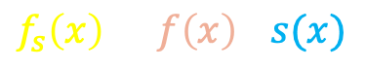
Pushing further removes overlaps
$$f_{s}\left(x\right)=f\left(x\right) . s(x)$$
$$|F\left(ω\right)|$$
$$F_{s}\left(ω\right)=F\left(ω\right) ⊗S(ω)$$
-$ω$
0
+$ω$
aliases do not overlap
CONVOLVE
MULTIPLY
$$|S\left(ω\right)|$$
-$ω$
0
+$ω$

Slide 12



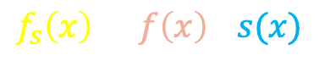
Higher sampling rate = stretched out spectrum
$$f_{s}\left(x\right)=f\left(x\right) . s(x)$$
$$|F\left(ω\right)|$$
-$ω$
0
+$ω$
CONVOLVE
MULTIPLY
$$|S\left(ω\right)|$$
-$ω$
0
+$ω$

Slide 13
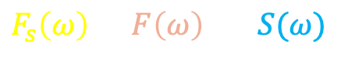
Removing aliases: 1) Increase sampling rate
$$F_{s}\left(ω\right)=F\left(ω\right) ⊗S(ω)$$

Slide 14
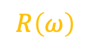
Removing aliases: 2) Crop signal (Fourier)
original signal
if sampling is
sufficiently dense
reconstructed signal
$$F_{r}\left(ω\right)= R\left(ω\right) . \left( F\left(ω\right) ⊗S\left(ω\right) \right)=F\left(ω\right)$$
multiply
convolve
select central replica
reconstruction function/filter/kernel
$$R\left(ω\right)$$
zero out aliases

Slide 15
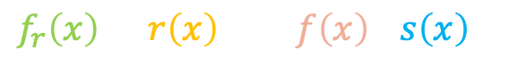
Convolve (Primal) = Crop (Fourier)
$$f_{r}\left(x\right)=r\left(x\right)⊗( f\left(x\right) . s\left(x\right) )$$
$$F_{r}\left(ω\right)= R\left(ω\right) . \left( F\left(ω\right) ⊗S\left(ω\right) \right)=F\left(ω\right)$$

Slide 16

Convolve (Primal) = Crop (Fourier)
$$f_{r}\left(x\right)=r\left(x\right)⊗( f\left(x\right) . s\left(x\right) )$$
$$F_{r}\left(ω\right)= R\left(ω\right) . \left( F\left(ω\right) ⊗S\left(ω\right) \right)=F\left(ω\right)$$
aliasing

Slide 17


Convolve (Primal) = Crop (Fourier)
Fourier Transform
$$f_{r}\left(x\right)=r\left(x\right)⊗( f\left(x\right) . s\left(x\right) )$$
$$F_{r}\left(ω\right)= R\left(ω\right) . \left( F\left(ω\right) ⊗S\left(ω\right) \right)=F\left(ω\right)$$
Inverse Fourier Transform
aliasing

Slide 18


(Nyquist-Shannon) Sampling Theorem
Sampling rate > 2B guarantees no aliasing
Provided:
Function is bandlimited (B is max frequency)
Sampling is regular (comb function)
-B
$$|F\left(ω\right)|$$
B
Bandlimited
-$ω$
0
+$ω$
aliasing

Slide 19
For any dimension: e.g. pixels in 2D
aliasing

Slide 20
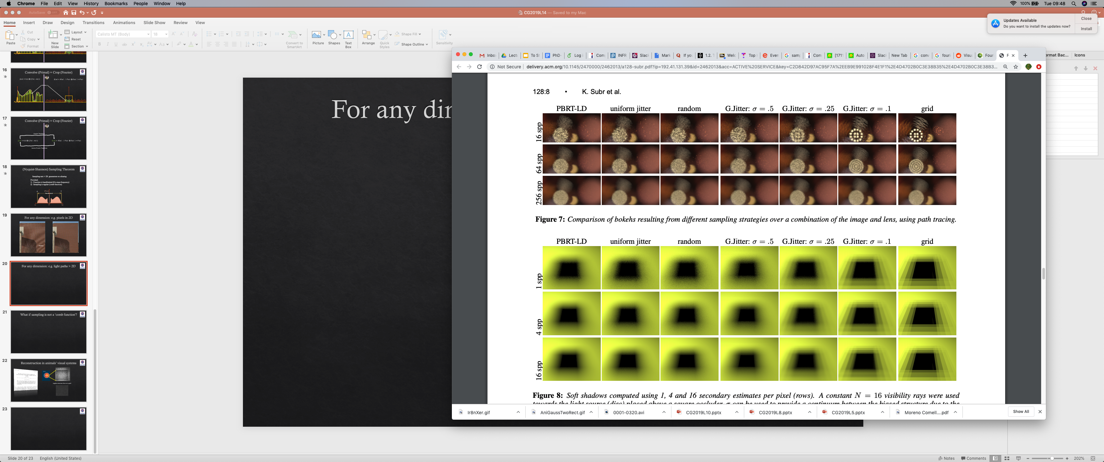
For any dimension: e.g. light paths > 2D
comb (regular grid)
16 spp
1 spp
But this is numerical integration, not reconstruction !
What is the connection
between these two classes of problems?
64 spp
4 spp
256 spp
16 spp

Slide 21
Adding randomness is good. Why?
comb (regular grid)
jittered grid
16 spp
random noise is
less objectionable
although undesirable
structured artifacts are visually disturbing
1 spp

Slide 22
Minimum distance between samples
structure + random

Slide 23
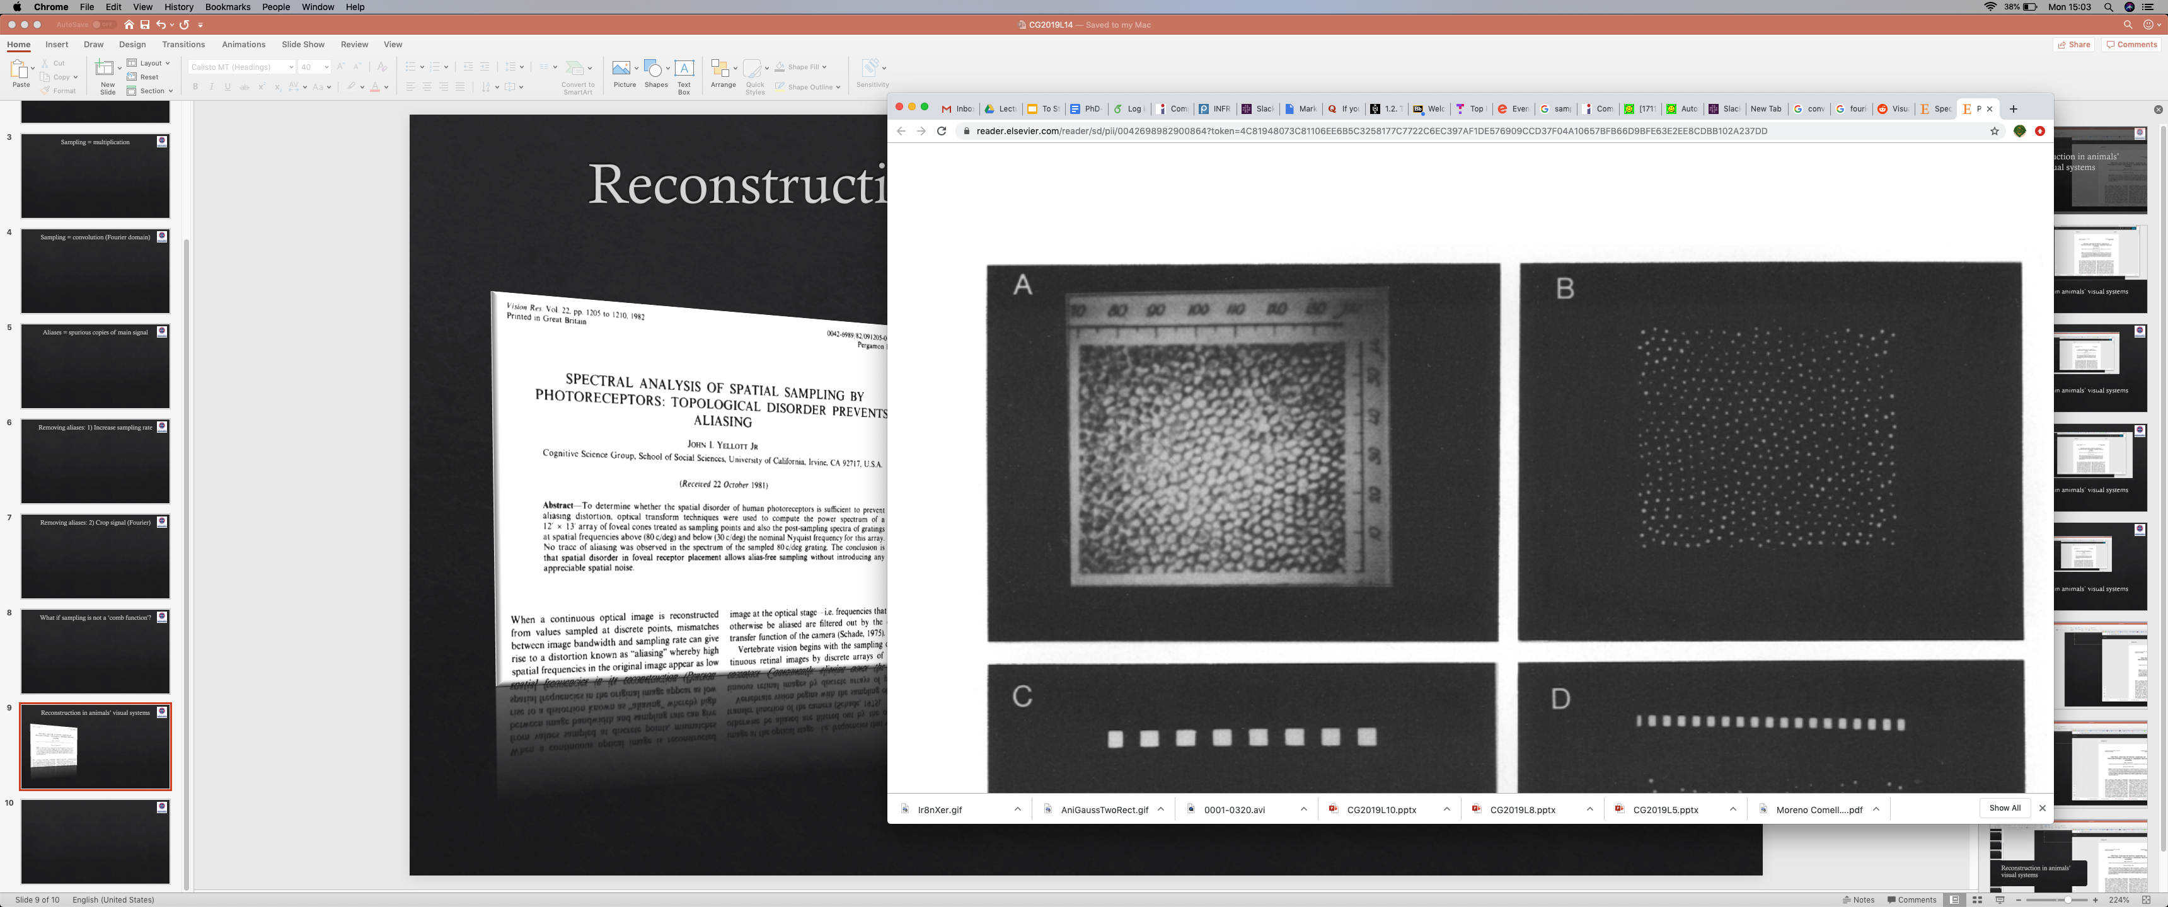
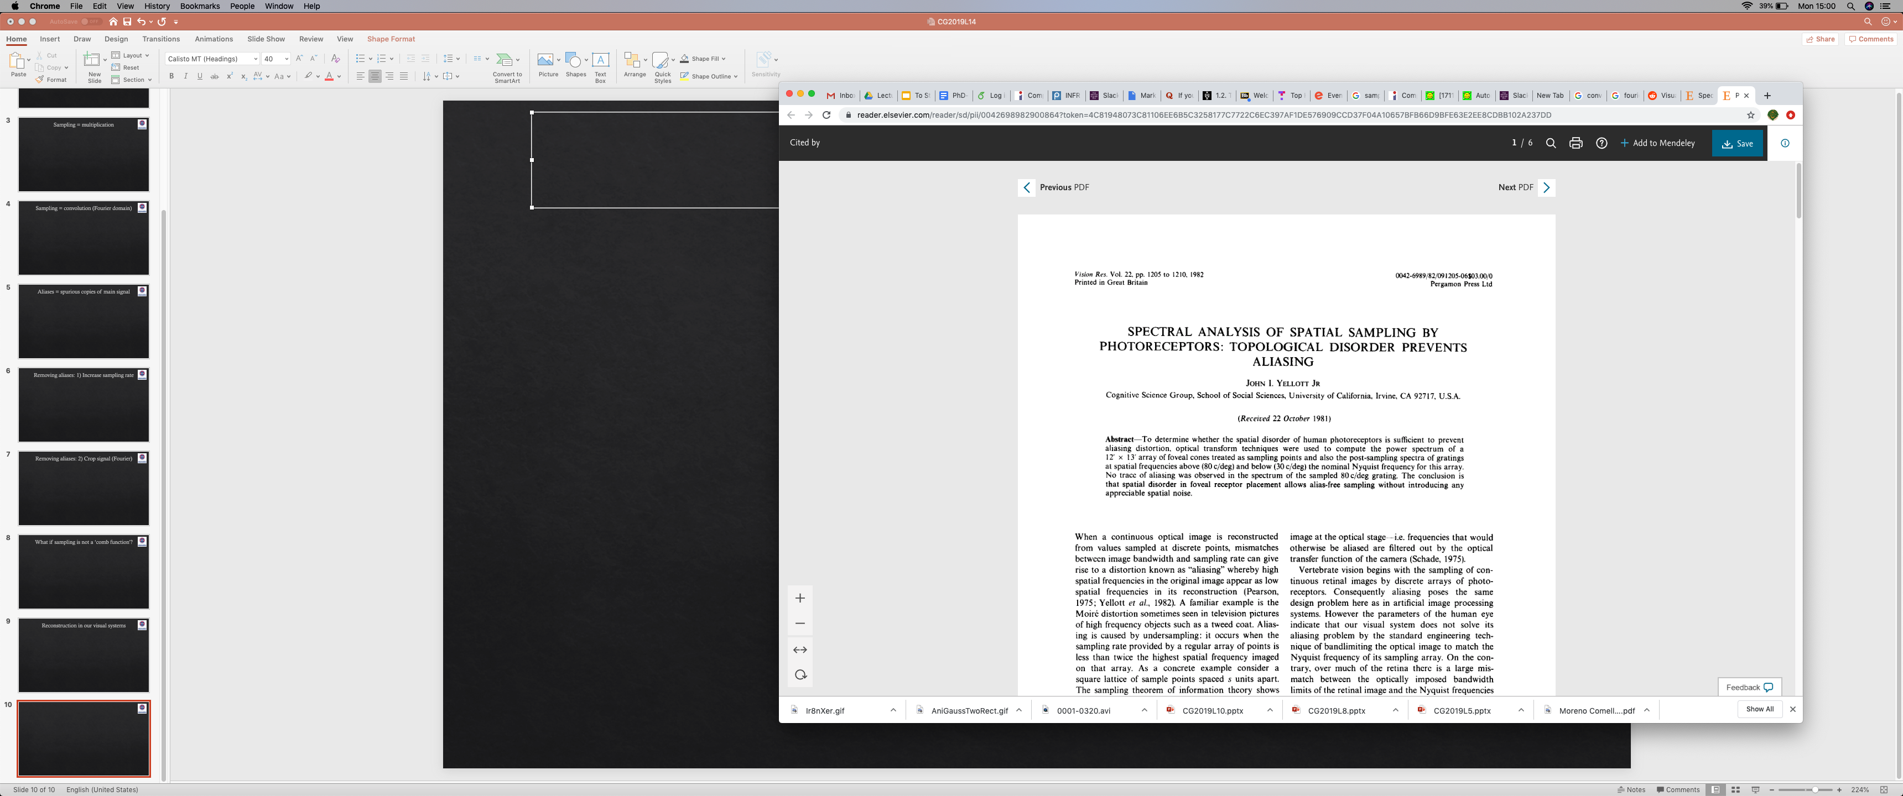
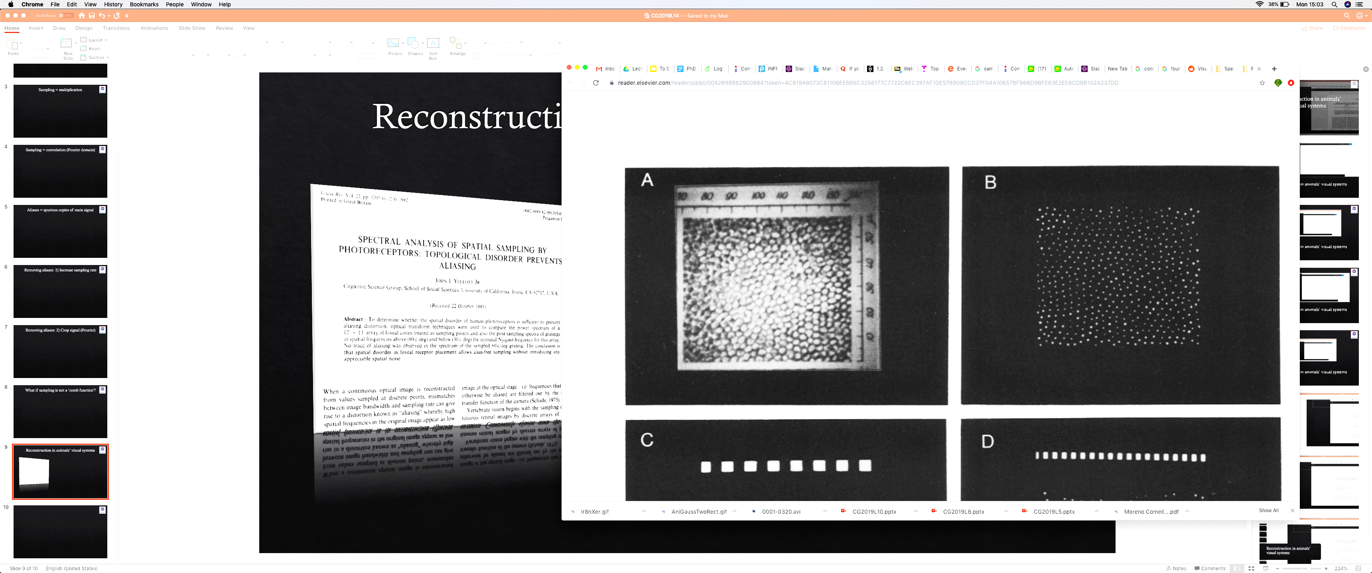
Reconstruction in animals’ visual systems
regular structure but not a grid

Slide 24
Reconstruction in animals’ visual systems

Slide 25


Gap in low-frequencies in Fourier spectrum
not a comb!
not a comb!
$$|S\left(ω\right)|$$
appear random, but minimum distance enforced
important
-$ω$
0
+$ω$
x

Slide 26
Random sampling spectrum is flat
not a comb!
not a comb!
random
$$|S\left(ω\right)|$$
-$ω$
0
+$ω$
x

Slide 27
Gap in low-frequencies in Fourier spectrum
not a comb!
not a comb!
$$|S\left(ω\right)|$$
appear random, but minimum distance enforced
important
-$ω$
0
+$ω$
x

Slide 28
Thought exercise
What does this mean for reconstruction?

Slide 29
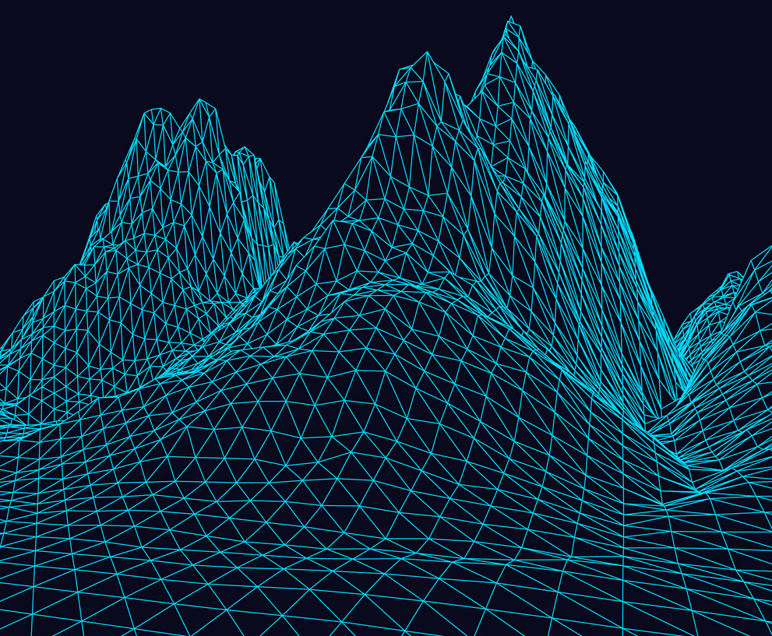
Fast rendering?

Slide 30
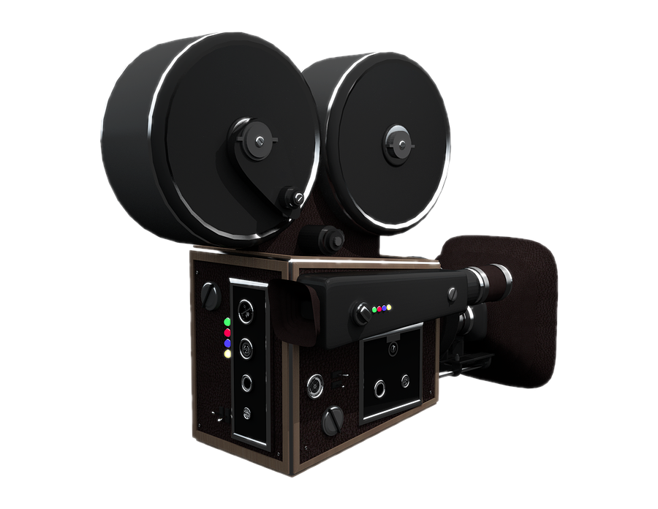
Fast rendering?

Slide 31
Fast rendering?

Slide 32
Ray tracing – slow but physically based

Slide 33
How else can we render?

Slide 34



Remember our projective transformation?
y
$$(X, Y, Z)$$
$$f$$
3D world
z=1 plane
pinhole
z
$$(−f.\frac{X}{Z},−f.\frac{Y}{Z}, −f)$$
z

Slide 35
Project each vertex (Matrix multiplication)

Slide 36
What about `in-between’ spaces?
?

Slide 37
Rasterisation

Slide 38
Considerations
Define geometry using vertices
Some geometry might not be visible
Fill space between vertices somehow
Multiple primitives might project onto the same pixel
Lighting/shading calculation
Speed, maybe use the GPU

Slide 39

… 1994
Vertex Data
Vertex Transform and Lighting
Primitive
Setup and Rasterization
Fragment Coloring and Texturing
Blending
Pixel Data
Texture Store

Slide 40
… 1992
Vertex Data
Vertex Transform and Lighting
Primitive
Setup and Rasterization
Fragment Coloring and Texturing
Blending
Pixel Data
Texture Store
Application Programming Interface (API) for
functionality that was implemented in hardware

Slide 41
… 2004
2.0
Vertex Data
Vertex Transform and Lighting
Primitive
Setup and Rasterization
Fragment Coloring and Texturing
Blending
Pixel Data
Texture Store

Slide 42
… 2010
4.1
(latest is 4.6)
Vertex Data
Vertex Shader
Primitive
Setup and Rasterization
Fragment Shader
Blending
Tessellation Control Shader
Tessellation Evaluation Shader
Geometry Shader
Pixel Data
Texture Store

Slide 43
Developing applications
Game/application main control logic
Vertex Shader
Geometry Shader
Fragment Shader

Slide 44
Real-time rendering APIs

Slide 45
The big picture
https://en.wikipedia.org/wiki/Vulkan_(API)

Slide 46
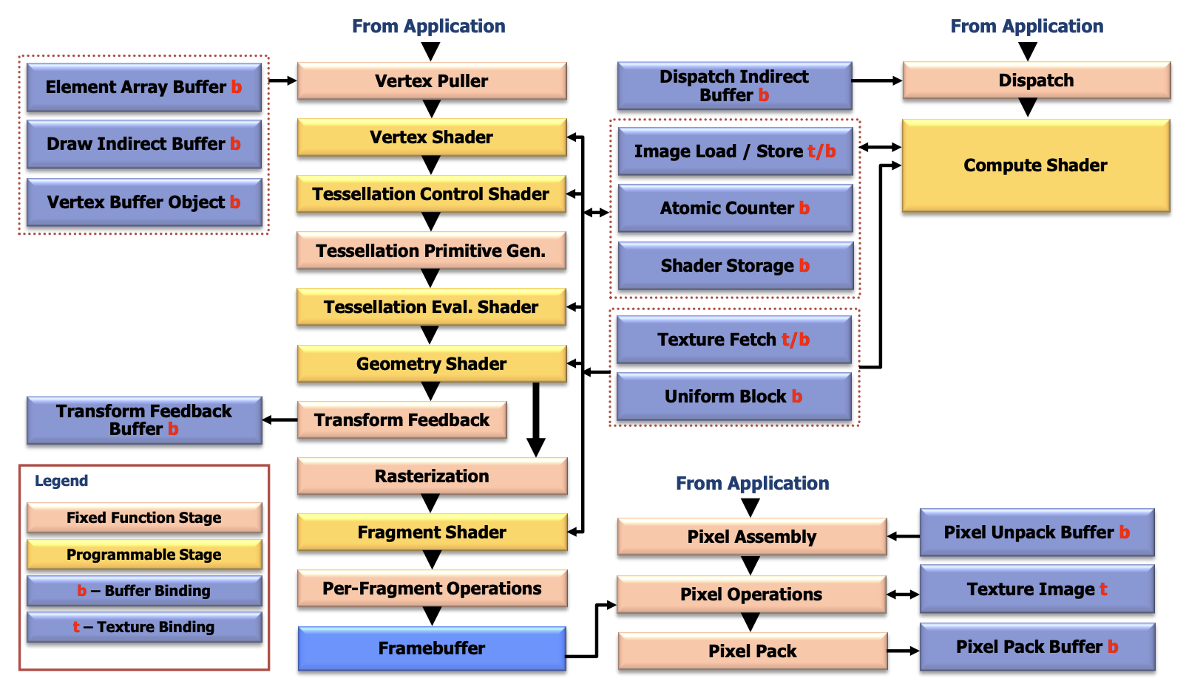
https://registry.khronos.org/OpenGL/specs/gl/glspec46.core.pdf

Slide 47
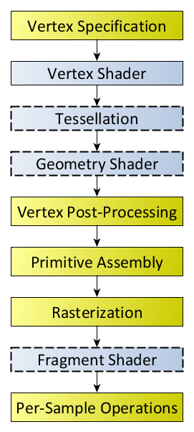
https://wikis.khronos.org/opengl/Rendering_Pipeline_Overview

Slide 48
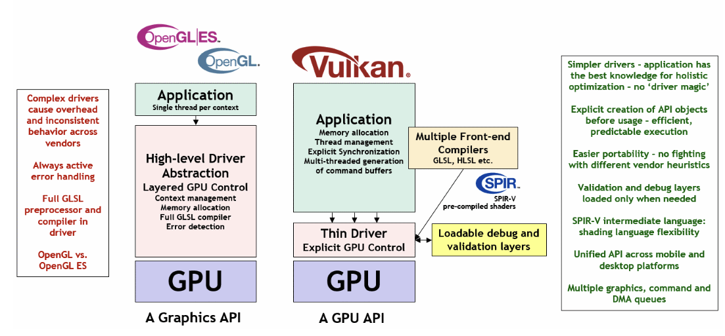
What is Vulkan
https://docs.vulkan.org/guide/latest/what_is_vulkan.html
https://docs.vulkan.org/tutorial/latest/00_Introduction.html

Slide 49
graphics pipeline
output image
(render target)

Slide 50
input
assembler
vertex
shader
hull
shader
domain
shader
geometry
shader
pixel
shader
output
merger
tessellator
rasteriser
output image
(render target)
fixed functions – change parameters
shaders – fully programmable

Slide 51
input
assembler
vertex
shader
hull
shader
tessellator
domain
shader
geometry
shader
rasteriser
pixel
shader
output
merger
0.2754 -0.5519 0.8320 0.0358 0.2428 0.7524 0.3252 0.5729
0.9154 0.3357 -0.9977 0.1759 0.9174 0.4477 0.1256 0.8853
-0.5186 0.6888 -0.0751 0.7218 0.2691 0.5301 0.4996 0.6851
0.3522 -0.3111 -0.1513 0.4735 0.7655 0.7809 0.5428 0.3092
-0.4219 0.5610 -0.0782 0.1527 0.1887 0.6633 0.4481 0.5993
0.3436 0.3507 0.5403 0.3411 0.2875 0.5849 0.6090 0.5357
0.3903 -0.9866 -0.3551 0.6074 0.0911 0.7086 0.5775 0.4054
-0.8640 0.2043 0.5695 0.1917 0.5762 0.2175 0.3645 0.9055
-0.4904 -0.2265 -0.0573 0.7384 0.6834 0.7053 0.6583 0.2633
0.2754 -0.5519 0.8320
0.9154 0.3357 -0.9977
-0.5186 0.6888 -0.0751
0.3522 -0.3111 -0.1513
-0.4219 0.5610 -0.0782
0.3436 0.3507 0.5403
0.3903 -0.9866 -0.3551
-0.8640 0.2043 0.5695
-0.4904 -0.2265 -0.0573
0.0358 0.2428
0.1759 0.9174
0.7218 0.2691
0.4735 0.7655
0.1527 0.1887
0.3411 0.2875
0.6074 0.0911
0.1917 0.5762
0.7384 0.6834
0.7524 0.3252 0.5729
0.4477 0.1256 0.8853
0.5301 0.4996 0.6851
0.7809 0.5428 0.3092
0.6633 0.4481 0.5993
0.5849 0.6090 0.5357
0.7086 0.5775 0.4054
0.2175 0.3645 0.9055
0.7053 0.6583 0.2633
0
1
2
3
4
5
6
7
8
input
assembler
position
FLOAT32
UV co-ord.
FLOAT 32
normal
FLOAT32
id
UINT16

Slide 52
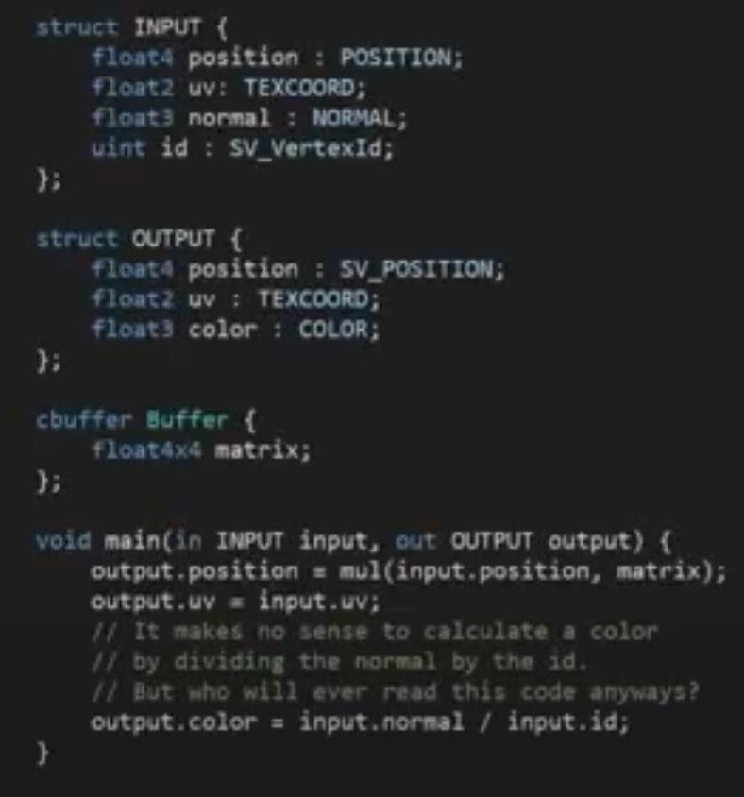
input
assembler
vertex
shader
hull
shader
tessellator
domain
shader
geometry
shader
rasteriser
pixel
shader
output
merger
Matrix
vertex attributes
transformed vertex attributes
position
0.2754 -0.5519 0.8320
position
0.2344 -0.1519 0.3320
UV co-ord.
0.0358 0.2428
vertex
shader
UV co-ord.
0.6358 0.8428
normal
0.7524 0.3252 0.5729
normal
0.1524 0.7252 0.3729
id
colour
.5 .5 .5
0

Slide 53
input
assembler
vertex
shader
hull
shader
tessellator
domain
shader
geometry
shader
rasteriser
pixel
shader
output
merger
tessellation
https://computeranimations.wordpress.com/2015/03/16/rasterization-of-parametric-curves-using-tessellation-shaders-in-glsl/

Slide 54
input
assembler
vertex
shader
hull
shader
tessellator
domain
shader
geometry
shader
rasteriser
pixel
shader
output
merger
input primitives
output primitives
geometry
shader
https://computeranimations.wordpress.com/2015/03/16/rasterization-of-parametric-curves-using-tessellation-shaders-in-glsl/

Slide 55
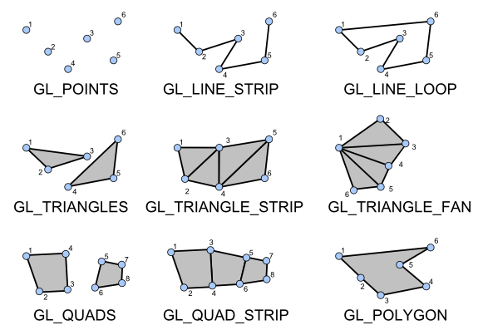
Primitive assembly – OpenGL supported

Slide 56
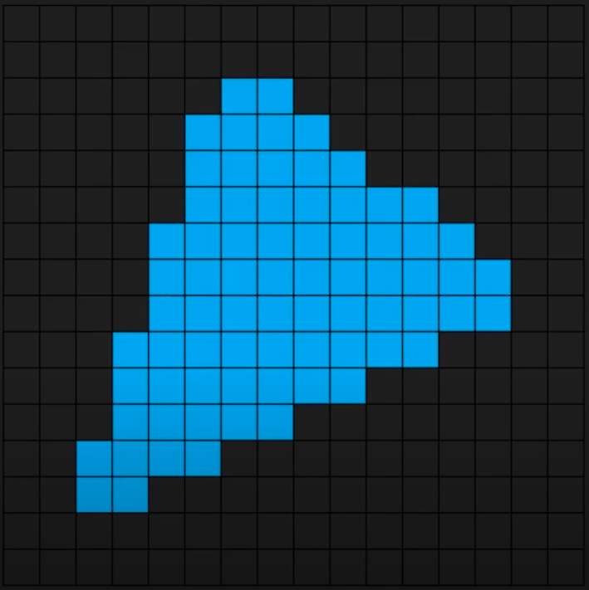
input
assembler
vertex
shader
hull
shader
tessellator
domain
shader
geometry
shader
rasteriser
pixel
shader
output
merger
rasteriser

Slide 57
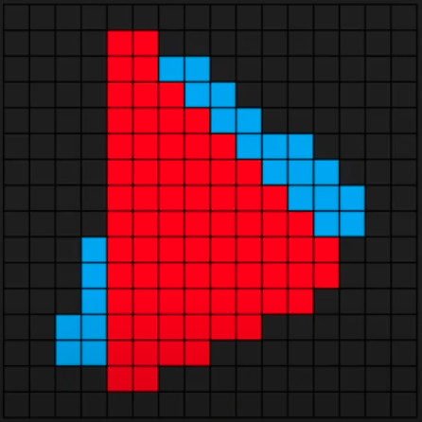
input
assembler
vertex
shader
hull
shader
tessellator
domain
shader
geometry
shader
rasteriser
pixel
shader
output
merger
rasteriser

Slide 58
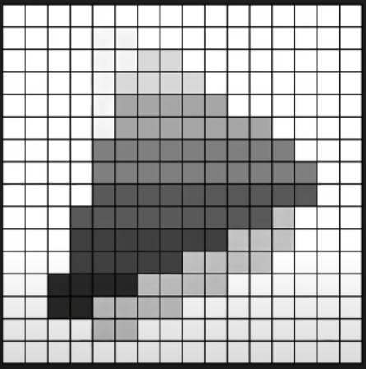
input
assembler
vertex
shader
hull
shader
tessellator
domain
shader
geometry
shader
rasteriser
pixel
shader
output
merger
rasteriser
depth map
(z-buffer)

Slide 59
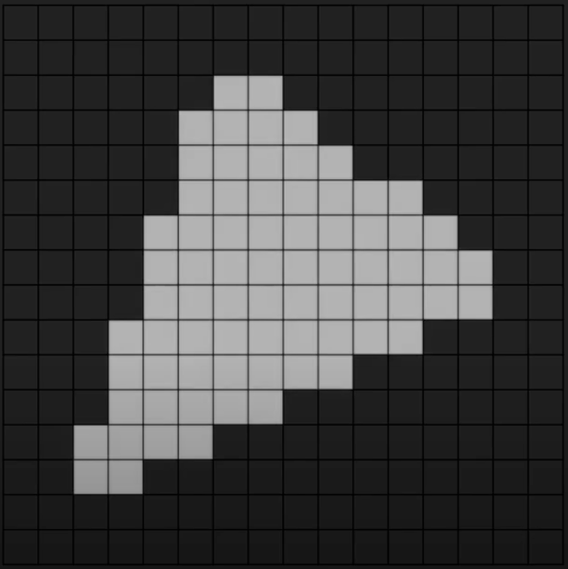
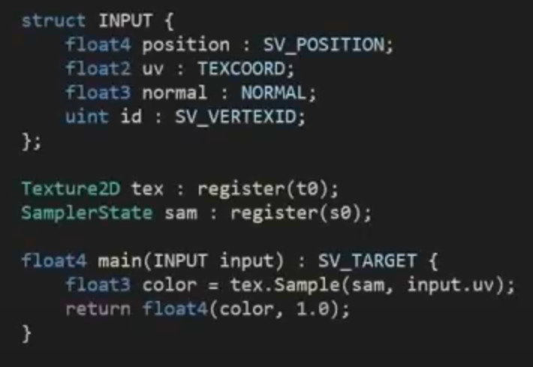
input
assembler
vertex
shader
hull
shader
tessellator
domain
shader
geometry
shader
rasteriser
pixel
shader
output
merger
Texture
Sampler
pixel
shader
colour of each pixel?

Slide 60
input
assembler
vertex
shader
hull
shader
tessellator
domain
shader
geometry
shader
rasteriser
pixel
shader
output
merger
render target
depth buffer
fragment colour
output
merger
fragment depth

Slide 61
graphics pipeline
output image
(render target)
Here is a good talk highlighting shortcomings, if you are interested…

Slide 62
Quiz – which part of the pipeline …
Define geometry using vertices
Some geometry might not be visible
Fill space between vertices somehow
Multiple primitives might project onto the same pixel
Lighting/shading calculation
Speed, maybe use the GPU

